Slide 1
INTRODUCTORY NOTES FOR MFS514 INTERNATIONAL TRADE

Slide 2
International trade
International trade is the exchange of capital, goods, and services across international borders or territories.
In most countries, such trade represents a significant share of gross domestic product (GDP).
While international trade has been present throughout much of history, its economic, social, and political importance has been on the rise in recent centuries.

Slide 3
Autarky
Autarky is the quality of being self-sufficient. Usually the term is applied to political states or their economic systems. The latter are called closed economies.
Autarky exists whenever an entity can survive or continue its activities without external assistance or international trade.

Slide 4
Free trade
Free trade is a policy by which a government does not discriminate against imports or interfere with exports by applying tariffs (to imports) or subsidies (to exports) or quotas.
According to the law of comparative advantage, the policy permits trading partners mutual gains from trade of goods and services

Slide 5
Free Trade
Under a free trade policy, prices emerge from the equilibration of supply and demand, and are the sole determinant of resource allocation.

Slide 6
Features of free trade
Trade of goods without taxes (including tariffs) or other trade barriers (e.g., quotas on imports or subsidies for producers)
The absence of "trade-distorting" policies (such as taxes, subsidies, regulations, or laws) that give some firms, households, or factors of production an advantage over others
Free access to markets
Free access to market information

Slide 7
Advantages of free trade
Advantages of free trade
Disadvantages of free trade
Specialisation leading to increased output
Trade allows economies of scale (larger market to sell to)
Lower price and increased choice
Competition and innovation
Risk – interdependence, over-reliance on trade, loss of control
Unemployment (perhaps)
Income inequality
Environmental impact
Culture

Slide 8
Protectionism
Protectionism is the economic policy of restraining trade between states through methods such as tariffs on imported goods, restrictive quotas, and a variety of other government regulations designed to allow (according to proponents) "fair competition" between imports and goods and services produced domestically

Slide 9
Protectionism
This policy contrasts with free trade, where government barriers to trade are kept to a minimum. In recent years, it has become closely aligned with anti-globalization.

Slide 10
Protectionist policies
Tariffs
Import quotas
Administrative barriers: Countries are sometimes accused of using their various administrative rules (e.g. regarding food safety, environmental standards, electrical safety, etc.) as a way to introduce barriers to imports

Slide 11
Protectionist policies
Anti-dumping legislation

Slide 12
Terms of trade
Terms of trade or TOT is (Price of exportable goods)/(Price of importable goods).
Terms of Trade is the ratio of quantities of domestic goods that a country must give up to obtain a unit of imported goods.

Slide 13
Liberalization
Liberalization refers to a relaxation of previous government restrictions, usually in areas of social or economic policy.
In some contexts this process or concept is often, but not always, referred to as deregulation.
Liberalization of autocratic regimes may precede democratization

Slide 14
ASSIGNMENT 2
Discuss the role of trade in economic development (group 1)
Discuss the potential opportunities and current challenges facing international agricultural trade in Zimbabwe ( group 2)

Slide 15
Difference between Internal trade and International trade
International trade
Involves the exchange of goods and services between two or more nations
May require the use of foreign currency
Countries need to adhere to international trade agreements for example on the use of tariffs and quotas
Internal trade
Involves movement of goods and services within a given country
Does not require the use of foreign currency
Internal trade is less complex as only conditions within a given country apply

Slide 16
THE EVOLUTION OF TRADE THEORY
The major task of trade theory is to answer the following questions:
What goods are traded internationally and what are the fundamental laws that govern the international allocation of resources and the flow of trade?
at what prices are the goods and services exchanged, or what are the terms of trade? - How international trade is related to the efficient use of scarce resources?
what are the gains from trade and where do they come from? How are these gains divided among the trading countries? - What is the impact of international trade in equitable distribution world-wide?

Slide 17
THE EVOLUTION OF TRADE THEORY
During the period from the sixteenth to the middle eighteenth century Britain, Spain, France, and Netherlands were the most developed countries with a high level of government intervention in the economy.
Their governments were concerned with the ways of maintaining their own power and wealth.
The economic philosophy that properly reflected these goals was known as mercantilism.

Slide 18
THE EVOLUTION OF TRADE THEORY
Mercantilists argued that the best way for a nation to enjoy faster growth was to export more than it imported.
The revenue would be a real inflow of gold. Since the amount of gold was fixed in the short run, gains from trade might be enjoyed only at the expense of the other nations.
That is why mercantilists advocated import restrictions and export promotion.

Slide 19
THE EVOLUTION OF TRADE THEORY
Mercantilists’ views were challenged by Adam Smith who advocated free trade based on absolute advantages of nations.
He proved that the advantages of international division of labor and specialization would be shared by all nations who may benefit simultaneously from free international trade.

Slide 20
THE EVOLUTION OF TRADE THEORY
Thus, when nations specialize in industries where they have absolute factor advantages, gains from trade come to every nation and not at the expense of others and there is no need for government intervention that only deteriorates allocation of resources and productivity.
However Smith did not explain the case when a nation had absolute advantages in the production of all goods

Slide 21
THE EVOLUTION OF TRADE THEORY
The weakness of Smith view was overcome by David Ricardo who developed the theory of comparative advantages to prove that mutually beneficial trade could occur even when one nation was absolutely more efficient in the production of all goods.
According to Ricardo, nations specialise in industries where they have lower opportunity cost and trade based on these comparative advantages all the countries enjoy gains from international trade.

Slide 22
THE EVOLUTION OF TRADE THEORY
David Ricardo’s views were based on the labour theory of value that stresses on the role of labour in value creation.
However, Ricardo did not analyze the effect of resource endowments on productivity and international specialization and the influence of trade on the distribution of income.

Slide 23
THE EVOLUTION OF TRADE THEORY
In the 1930s two Swedish economists Eli Heckscher and Bertil Ohlin developed a model of factor endowment to study these issues.
They asserted that international trade is based on differences in factor endowments of nations.
Because of the different endowments of factors of production nations have comparative advantages in different industries and their relative price levels differ.

Slide 24
THE EVOLUTION OF TRADE THEORY
That is why each nation will export the goods intensive in its relatively abundant and cheap factor and import the goods intensive in its relatively scarce and expensive factor.
Thus, all nations will enjoy gains from trade simultaneously.

Slide 25
THE EVOLUTION OF TRADE THEORY
Empirical problems with the H-O model, known as the Leontief paradox, were exposed in empirical tests by Leontief who found that the United States tended to export labor intensive goods despite having capital abundance.
Trade based on economies of scale, trade based on technological gaps and product cycles needed a new explanation.
These issues were addresses by different theories.

Slide 26
THE EVOLUTION OF TRADE THEORY
For example, Raymond Vernon developed the theory of international product life cycle to explain trade based on technological gaps.
He asserts that the initial production of a new product usually requires skilled labour, which can be replaced by unskilled labour once the product acquires mass acceptance and is standardized.
Later this theory was extended to explain internationalization of industries in the international industry life cycle model.

Slide 27
THE EVOLUTION OF TRADE THEORY
Stefan Linder gave an explanation of intra-industry trade in his theory of overlapping demand, asserting that international trade in manufactured goods will be greater between nations with similar levels of per capita income than between those with dissimilar per capital income level.

Slide 28
THE EVOLUTION OF TRADE THEORY
A coherent explanation of modern international trade was given by Michael Porter who developed the theory of competitive advantages of nations.
He argues that competitiveness and hence international trade is determined by four factors encapsulated in the Porter Diamond.

Slide 29
THE EVOLUTION OF TRADE THEORY
These are Factor Conditions, Demand Conditions, the Structure of Firms and Rivalry and lastly the strength and existence of Related Firms and Supporting Industries.
Hence, industry clusters appear that create and enhance competitiveness of local firms. An important contribution of Porter’s theory is that he associates competitive advantages of nations with firm’s decision making. These are really firms that conduct international trade, not countries.

Slide 30
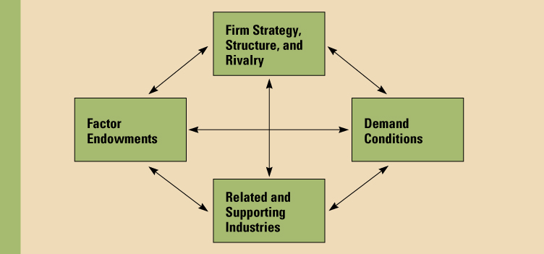
Porter’s Diamond

Slide 31
The Diamond
Success occurs where these attributes exist.
More/greater the attribute, the higher chance of success.
The diamond is mutually reinforcing.
4-32

Slide 32
THE EVOLUTION OF TRADE THEORY
In the 1990s, Alan Rugman’s approach has extended the concept of Porter’s “single” diamond in order to explain the evidence for further globalization revealed by some recent surveys, that the more international a firm was, the more it derived its competitive advantages from its foreign affiliates.
Rugman argues that the deepening structural integration of the world economy and the burgeoning of alliance capitalism are widening the geographical scope for creating or augmenting firm-specific competencies and learning experiences.
Any attempt to identify the geographical sources of such advantages must embrace the diamonds of other countries, particularly those with which the home-country firms have the most dealings by way of trade, FDI and non-equity co-operative ventures.

Slide 33
Why do nations trade
Economic doctrines of the capitalists in the 17th and 18th centuries included the mercantilists who believed that for a nation to become wealthy and powerful it had to export more than it imported.
The more gold or silver a nation had the richer and more powerful it was, thus governments had to promote exports and discourage importation.
Mercantilists advocated for strict government control of all economic activity.
The question, why nations trade was illustrated by the classical trade theories postulated by Adam Smith and David Ricardo based on absolute and comparative advantage respectively

Slide 34
Absolute advantage
Smith assumed that each country could produce one or more commodities at a lower real cost than its trading partners.
It then follows that each country will beneﬁt from specialization in those commodities in which it has an absolute advantage (i.e. can produce at lower real cost than another country), exporting them and importing other commodities that it produces at a higher real cost than does another country.

Slide 35
Absolute advantage
For example, if 10 hours of labour are required to produce a shirt, and 40 hours to produce a pair of shoes, then four shirts will exchange for one pair of shoes.
The labour embodied in four shirts equals the labour embodied in one pair of shoes.
This argument holds for a given market area within which labour can move freely from one industry to another and one place to another

Slide 36
Absolute advantage
In our example of shirts and shoes, no one would give more than four shirts for one pair of shoes because that would entail a cost of more than 40 hours of labour to obtain a pair of shoes.
One instead can obtain a pair of shoes directly by expending 40 hours of labour.
No one would accept fewer than four shirts for one pair of shoes for the same reason.
Competition in the market, and the mobility of labour between industries within a nation, thus cause goods to exchange in proportion to their labour cost

Slide 37
Absolute advantage
Because of legal and cultural restrictions, however, labour does not move freely between nations.
To simplify the analysis, we make the classical economists’ assumption that labour is completely immobile between nations.
If labour requirements differ across countries, then in the absence of trade, prices of goods will differ across countries.

Slide 38
Absolute advantage
 | Scotland (labour days) | Italy (labour days)
Wine (1 barrel) | 120 | 20
Cloth (1 bolt) | 30 | 100

Slide 39
Absolute advantage
Suppose that, as shown in the table, in Scotland it takes 30 days to produce a bolt of cloth and 120 days to produce a barrel of wine, whereas in Italy it takes 100 days to produce a bolt of cloth and only 20 days to produce a barrel of wine.

Slide 40
Absolute advantage
Scotland has an absolute advantage in cloth production – it can produce a bolt of cloth at a lower real cost than can Italy – whereas Italy has an absolute advantage in wine production.
Consequently, each country will beneﬁt by specializing in the commodity in which it has an absolute advantage, obtaining the other commodity through trade.

Slide 41
Absolute advantage
In the absence of trade, in Scotland one barrel of wine will exchange for four bolts of cloth(because they require equal amounts of labour); in Italy one barrel of wine will exchange for one-ﬁfth of a bolt of cloth.
Scotland will beneﬁt if it can trade less than four bolts of cloth for one barrel of wine, Italy if it can obtain more than one-ﬁfth of a bolt of cloth for one barrel of wine.

Slide 42
Absolute advantage
Clearly, both countries can gain at an intermediate ratio such as one barrel of wine for one bolt of cloth.
By shifting 120 days of labour from wine to cloth, Scotland could produce four additional bolts of cloth, worth four barrels of wine in trade with Italy.
Scotland gets four barrels of wine instead of one. Italy obtains a similar gain through specialization in wine.

Slide 43
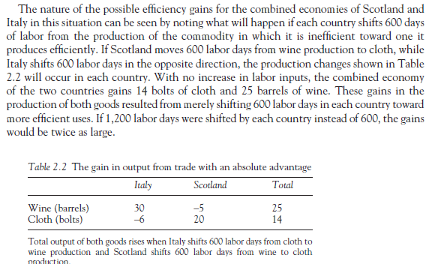

Slide 44
Comparative advantage
David Ricardo showed, that absolute cost advantages are not a necessary condition for two nations to gain from trade with each other.
Instead, trade will beneﬁt both nations provided only that their relative costs, that is, the ratios of their real costs in terms of labour inputs, are different for two or more commodities.
In short, trade depends on differences in comparative advantage, and one nation can proﬁtably trade with another even though its real costs are higher (or lower) in every commodity.

Slide 45
Comparative advantage
Comparative advantage exists when a country has a margin of superiority in the production of a good or service i.e. where the opportunity cost of production is lower.

Slide 46
Comparative advantage
Ricardo presented the case of potential trade in wine and cloth between Portugal and England, which we have modified here by using a different set of numbers.
The costs of producing a bolt of cloth or a barrel of wine in each of the two countries, measured in terms of days of labour, are given in table below.
As can be seen in this table, England is more efficient at the production of both goods.
Less labour is required to produce either good in England than in Portugal. That fact is irrelevant, however. What is important is that Portugal has a comparative advantage in wine, whereas England has a comparative advantage in cloth.

Slide 47
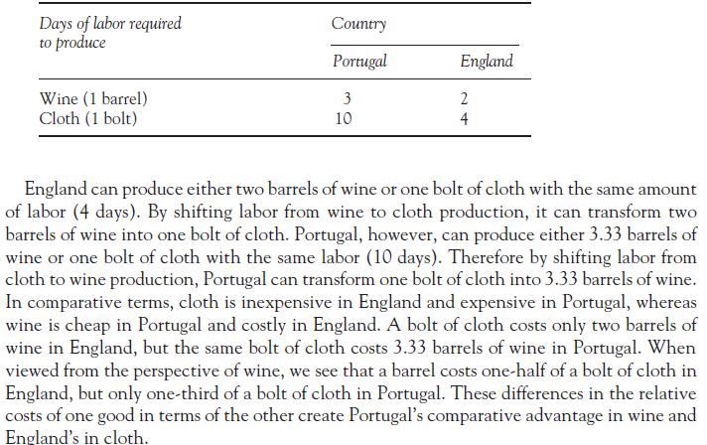

Slide 48
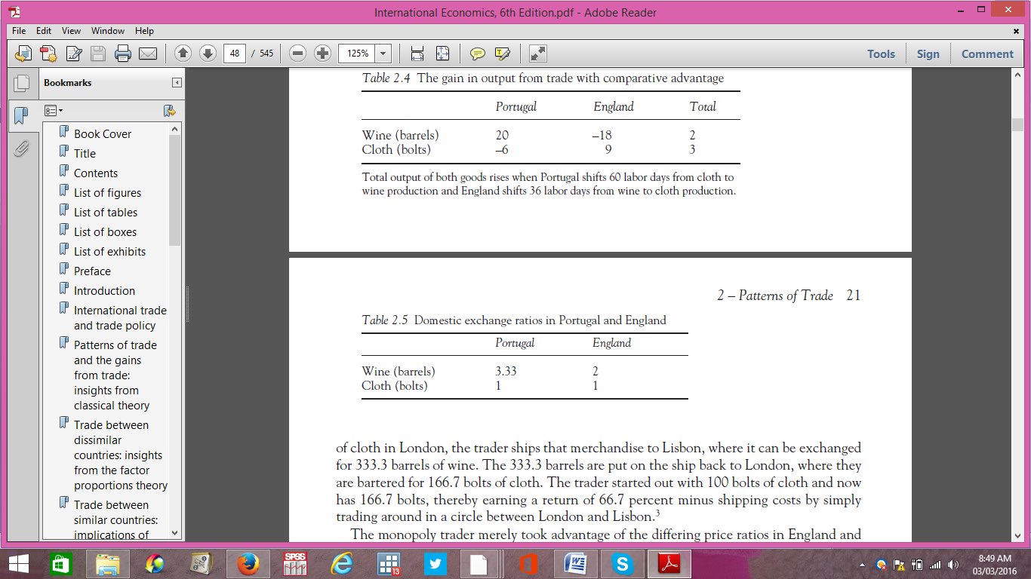

Slide 49
Comparative advantage
The efficiency gains that this pattern of comparative advantage makes possible can be seen by imagining that Portugal shifts 60 days of labour from the production of cloth to employment in the wine industry, whereas England shifts 36 days of labour in the opposite direction, that is, from wine to cloth production.

Slide 50
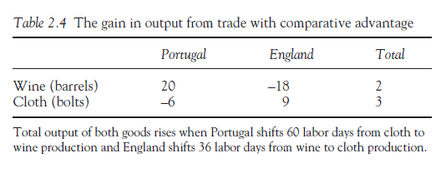

Slide 51
Assumptions underlying the concept of comparative advantage
Perfect occupational mobility of factors of production - resources used in one industry can be switched into another without any loss of efficiency
Constant returns to scale (i.e. doubling the inputs in each country leads to a doubling of total output)
No externalities arising from production and/or consumption
Transportation costs are ignored

Slide 52
What determines comparative advantage
The quantity and quality of factors of production available (e.g. the size and efficiency of the available labour force and the productivity of the existing stock of capital inputs).
If an economy can improve the quality of its labour force and increase the stock of capital available it can expand the productive potential in industries in which it has an advantage.
Investment in research & development (important in industries where patents give some firms significant market advantage)

Slide 53
What determines comparative advantage
Movements in the exchange rate. An appreciation of the exchange rate can cause exports from a country to increase in price. This makes them less competitive in international markets.
Long-term rates of inflation compared to other countries. For example if average inflation in Country X is 4% whilst in Country B it is 8% over a number of years, the goods and services produced by Country X will become relatively more expensive over time. This worsens their competitiveness and causes a switch in comparative advantage.

Slide 54
What determines comparative advantage
Import controls such as tariffs and quotas that can be used to create an artificial comparative advantage for a country's domestic producers- although most countries agree to abide by international trade agreements.
Non-price competitiveness of producers (e.g. product design, reliability, quality of after-sales support)

Slide 55
Gravity model of trade
Predicts bilateral trade flows based on the economic sizes of (often using GDP measurements) and distance between two units.
The model was first used by Tinbergen in 1962

Slide 56

Gravity model of trade

Slide 57
Gravity model of trade
Where F is the trade flow, M is the Gross Domestic Product, D is the distance and G is a constant.

Slide 58
Heckscher-Ohlin
The Heckscher–Ohlin model (H–O model) is a general equilibrium mathematical model of international trade, developed by Eli Heckscher and Bertil Ohlin at the Stockholm School of Economics.
It builds on David Ricardo's theory of comparative advantage by predicting patterns of commerce and production based on the factor endowments of a trading region.

Slide 59
Heckscher-Ohlin
The model essentially says that countries will export products that use their abundant and cheap factor(s) of production and import products that use the countries' scarce factor(s).

Slide 60
Heckscher-Ohlin
Relative endowments of the factors of production (land, labour, and capital) determine a country's comparative advantage.
Countries have comparative advantages in those goods for which the required factors of production are relatively abundant locally.
Goods that require inputs that are locally abundant will be cheaper to produce than those goods that require inputs that are locally scarce.

Slide 61
Heckscher-Ohlin
A country where capital and land are abundant but labour is scarce will have comparative advantage in goods that require lots of capital and land, but little labour
If capital and land are abundant, their prices will be low. As they are the main factors used in the production of the commodity, the price of the commodity will also be low—and thus attractive for both local consumption and export.
Labor intensive goods on the other hand will be very expensive to produce since labour is scarce and its price is high. Therefore, the country is better off importing those goods.

Slide 62
Heckscher-Ohlin
Assumptions of the H-O theory
Perfect competition in all markets
Full employment of factors of production
Full mobility of each factor of production within any country
No government intervention
Demand conditions are the same and given between the two countries
Technology is given

Slide 63
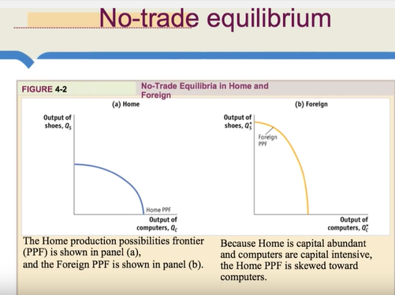

Slide 64
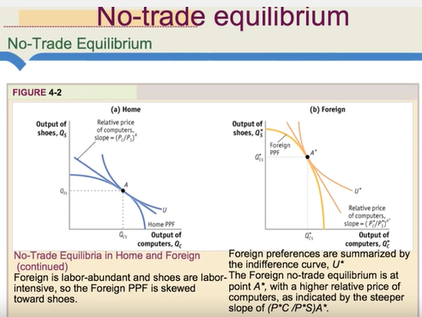

Slide 65
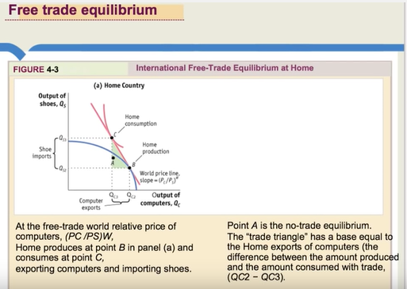

Slide 66
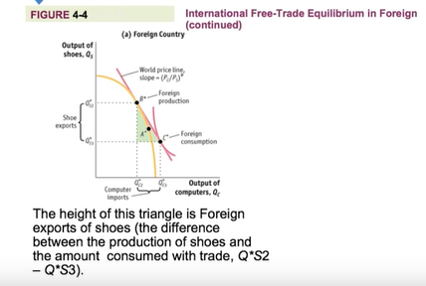

Slide 67
Price determination

Slide 68
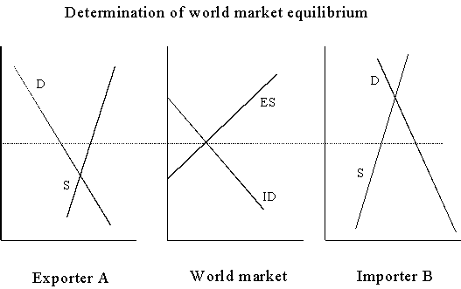

Slide 69
Price determination
The equilibrium international price, is determined by the intersection of A’s export supply curve with B’s import demand curve where the quantity supplied by A exactly equals the quantity demanded by B.
A’s export supply is the residual or difference between its domestic quantity supplied and domestic quantity demanded.
B’s import demand is the residual or difference between its domestic quantity demanded and domestic quantity supplied.

Slide 70
Tariffs and other barriers to trade

Slide 71
Types of Protectionism
Direct
Embargo
Tariff
Quota
Subsidy
Indirect
Voluntary Export Restraint (VER)
Exchange rate controls
Import licenses
Regulatory and administrative barriers

Slide 72
Why do Govts impose barriers to trade
Invalid arguments for protection
Job preservation and creation (output expands in the protected sector). Employment in the protected sector rises.
Fair play to domestic industry- this limits competition and is unfair to the consumer.
Preservation of the home market.

Slide 73
Why do Govts impose barriers to trade
Valid arguments for protectionism
Government revenue
Infant industry protection
Income redistribution

Slide 74
Administrative issues in imposing tariffs
In the past, tariffs (taxes on imports) were the dominant form of government regulation of trade, but that has changed.
Average tariff levels have fallen, in part due to the successful completion of several rounds of multilateral negotiations.
Governments, however, have sought ways to restrict trade without violating commitments to lower tariffs.

Slide 75
Administrative issues in imposing tariffs
Nontariff trade barriers, widely known as NTBs, have proliferated and have become the most active means of interference with trade.
A nontariff trade barrier is any government policy, other than a tariff, which reduces imports but does not similarly restrict domestic production of import substitutes.
Quotas, which are limits on the physical volume of a product that may be imported during a period of time, are the most important NTB, but there are many others.

Slide 76
Administrative issues in imposing tariffs
Import tariffs may be ad valorem(a percentage of the value of the imported article), speciﬁc (a given amount of money per unit, such as $0.50 per yard of cloth), or compound (a combination of ad valorem and speciﬁc, such as 10 percent ad valorem plus $0.20 per yard of cloth).

Slide 77
Administrative issues in imposing tariffs
Ad valorem tariffs have the administrative advantage of rising automatically with inﬂation and of taxing different qualities of products at the same percentage rate.
A tariff of 10 percent on wine produces proportionally more revenue as the price and quality of imported wine rise.
A speciﬁc tariff will not have this effect.

Slide 78
Administrative issues in imposing tariffs
A disadvantage of an ad valorem tariff is that it creates opportunities for cheating through what is called false invoicing or transfer pricing.
If a misleading low price is shown on the shipping invoice, part of the tariff can be avoided.

Slide 79
Tariffs in a partial equilibrium framework
Assume that the industry involved is a very small part of the total economy. It is so small, in fact, that changes in this industry have negligible effects on the rest of the economy, and these effects can be ignored. We call this framework partial equilibrium analysis.

Slide 80
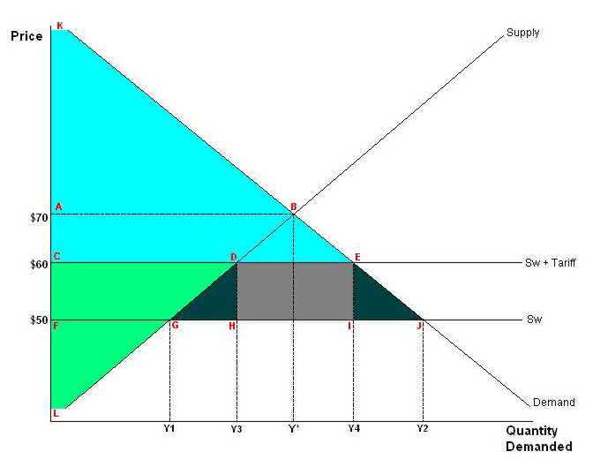

Slide 81
Tariffs in a partial equilibrium framework
If trade is free, oats will be imported into Country A at the prevailing world price, Pw. At that price, Country A’s total consumption will be Y2, its production will be Y1, and imports will make up the difference, between Y2 and Y1. Total supply (Y1 of domestic output plus the difference between Y2 and Y1 which are from imports) equals total demand (Y2) at that price.

Slide 82
Tariffs in a partial equilibrium framework
Suppose that Country A imposes a tariff, equal to T or $10 per bushel, on imports of oats. The immediate result of the tariff is that the price of oats in Country A will rise by the amount of the tariff to (SW t Tariff).

Slide 83
Tariffs in a partial equilibrium framework
We assume that the world price of oats remains unchanged when Country A imposes its tariff. That is, we assume that Country A is a small country whose actions will not affect the world market.
The increase in price has a number of effects.
The ﬁrst effect is that the consumption of oats is reduced from Y2 to Y4. The second effect is that domestic output rises from Y1 to Y3.

Slide 84
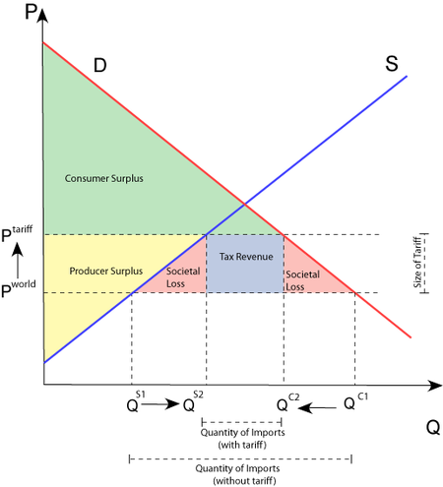

Slide 85
What are the arguments for using tariffs
Duties create revenue for the government
Increases the terms of trade for the country levying the duty
Will keep high cost producers in business
Protection of infant industries
Safeguards industries that are of military and strategic importance
Protects the country from dumping

Slide 86
Quotas and other nontariff trade barriers
Barriers to trade other than tariffs have become far more important in recent years as governments have looked for ways to restrict imports without raising tariffs that were reduced in GATT negotiations.
Quotas, which are limits on the physical volume of a product that may be imported per period of time.

Slide 87
Quantitative restrictions on import
Quotas or limits on the quantity of allowable imports have some effects that are similar to a tariff but others that are quite different.
Agricultural products often are protected by quotas, in many cases seasonal ones, although a major accomplishment of the Uruguay Round of trade negotiations is to require the conversion of these quotas into tariffs.

Slide 88
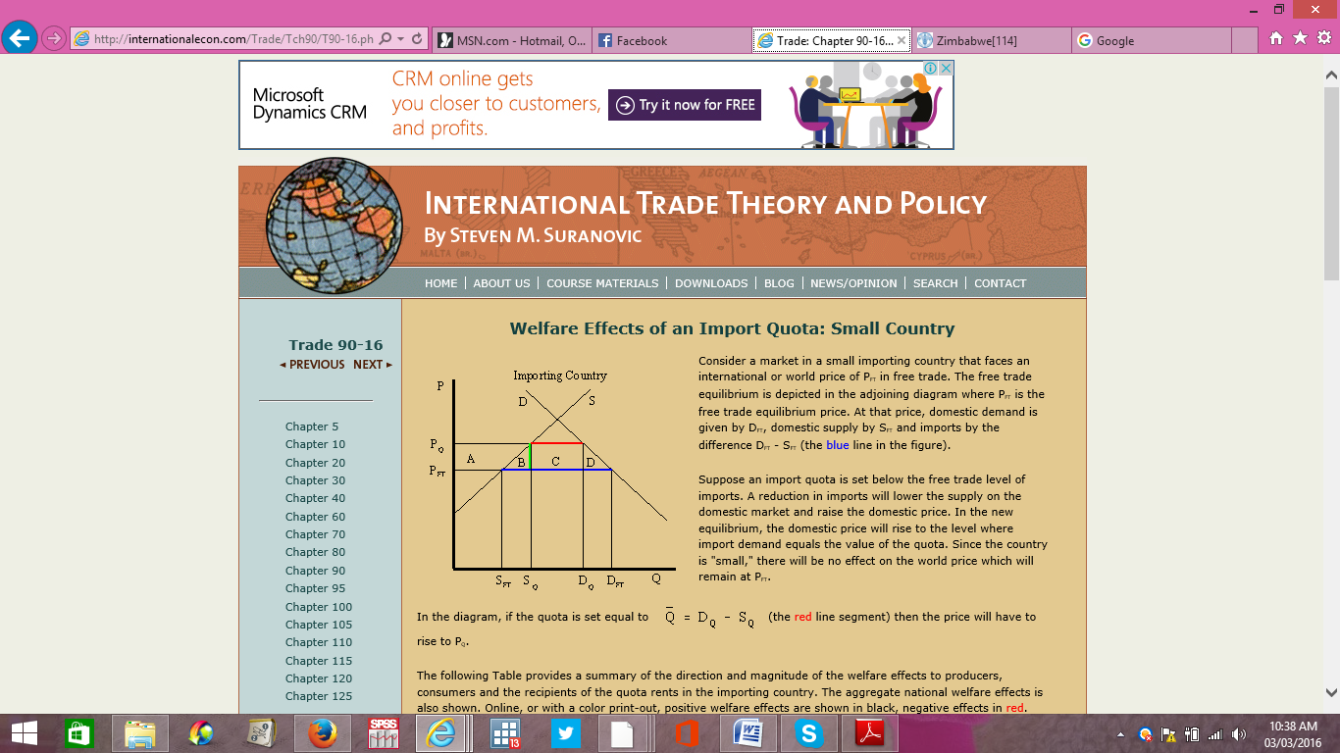

Slide 89
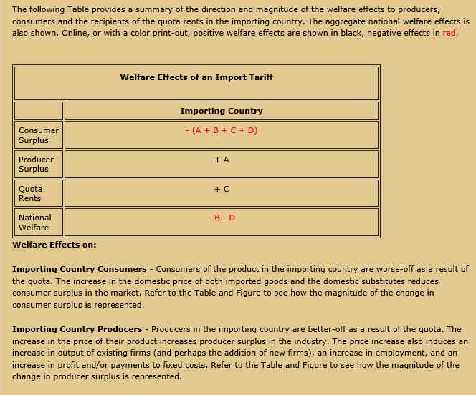

Slide 90
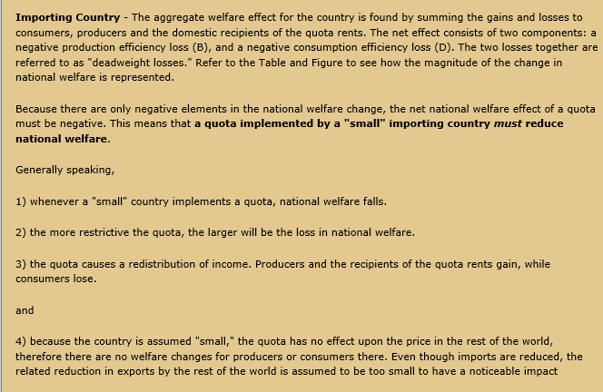

Slide 91
Disadvantages of a quota
A quota is much more rigid than a tariff (not flexible)
Are much more difficult to administer than tariffs
Result in competition being lessened and trade patterns fixed

Slide 92
Voluntary Export Restraint
A voluntary export restraint (VER) or voluntary export restriction is a government imposed limit on the quantity of goods that can be exported out of another country during a specified period of time.

Slide 93
Voluntary Export Restraints
A "voluntary" export restraint (VER) or "voluntary" export restriction is a government imposed limit on the quantity of goods that can be exported out of a country during a specified period of time.
Usually the importing country coerces the exporter into a "voluntary" restraint agreement, and the word voluntary is in quotes to indicate it's not truly voluntary

Slide 94
Voluntary Export Restraints
Typically VERs arise when the import-competing industries seek protection from a surge of imports from particular exporting countries.
VERs are then offered by the exporter to appease the importing country and to deter the other party from imposing even more explicit (and less flexible)trade barriers.

Slide 95
Voluntary Export Restraints
VERs are rarely completely voluntary. They represent a Beggar thy neighbour policy that seeks to shift economic activity (or preserve it) for the importing country, and has the effect of increasing costs for consumers there.

Slide 96
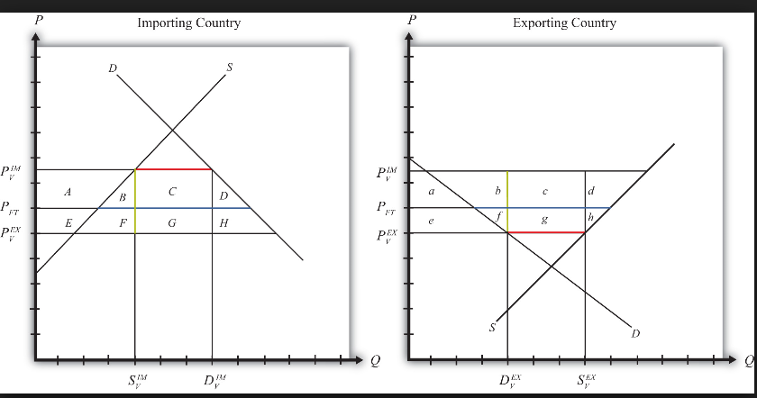

Slide 97
Export Subsidies
Export Subsidy is a government policy to encourage export of goods and discourage sale of goods on the domestic market through low-cost loans or tax relief for exporters.

Slide 98
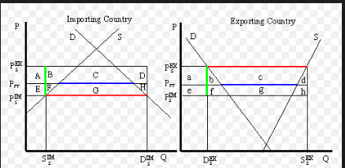

Slide 99
Export Tax
Although governments usually design trade policies to reduce imports or encourage exports, some countries have applied tariffs to exports.

Slide 100
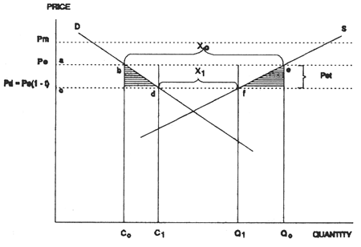

Slide 101
Export Tax
Introducing an export tax results in producers contracting output from Q0 to Q1 and domestic consumers purchasing C1 rather than C0.
Export tariffs may also be used to protect consumers from increases in world prices of an export commodity

Slide 102
Arguments for restricting imports

Slide 103
Increasing output and employment
It is often argued that protectionism is a desirable way of increasing output, incomes, and employment because of the multiplier effect of reduced imports. If imports can be cut by $10 billion, it is argued, the resulting $10 billion increase in production of import substitutes will start a Keynesian multiplier process that will ultimately increase domestic output

Slide 104
Closing a trade deﬁcit
Countries with large balance-of-payments deﬁcits sometimes view import restraints as a means of reducing or eliminating such problems.

Slide 105
The terms-of-trade argument
By imposing a tariff a large country may be able to turn the terms of trade in its favor.
This gain may be large enough to outweigh the loss from a reduced volume of trade.
So runs the terms-of-trade argument, which is also known as the “optimum tariff” case, although it is optimal only for the country imposing the tariff and not for the world.

Slide 106
The infant-industry argument
When production of a commodity ﬁrst begins in a country, the ﬁrms producing it are often small, inexperienced, and unfamiliar with the technology they are using.
Workers are also inexperienced and less efﬁcient than they will become in time.
During this breaking-in stage costs are higher than they will be later on, and infant ﬁrms in the new industry may need temporary protection from older, established ﬁrms in other countries.

Slide 107
Dumping
Another claim for protection is that imported goods beneﬁt from unfair trade practices.
These allegations include products that are dumped at unfairly low prices in foreign markets and those that beneﬁt from government subsidies.

Slide 108
Cultural or social values
The specialization that results from international trade may also be opposed for cultural and social reasons. Countries may wish to protect a way of life: small-scale agriculture, a village system, a diversiﬁed structure of production.

Slide 109
Revenues
Thus far, we have viewed government restrictions on imports solely as a means of protecting domestic producers, but tariffs are frequently a major source of revenue for governments.

Slide 110
International Commodity Agreements
International commodity agreements are meant to stabilize prices and they involve both producing and consuming countries.
Export Restriction Schemes
Are arrangements that restrict the quantity of a commodity marketed internationally by means of national quotas.

Slide 111
International Commodity Agreements
Buffer Stocks
Ensure that there is a set range (minimum and maximum Prices) within which the price of the commodity is allowed to fluctuate through the use of buffer stocks- that is purchases or sales f the commodity
Multi-lateral Contracts
These are contracts that specify maximum prices at which exporters ought to sell their products and the minimum prices at which consuming countries are obliged to purchase stipulated quantities from producing countries.

Slide 112
FOREIGN EXCHANGE

Slide 113
International Monetary System
Each country has a specific currency for conducting business transactions at the national level.
In international trade there is need to harmonize currencies from one type to the other.
The international monetary system comprises the institutional setup or the rules and regulations governing how debts are honored or paid between countries with different currencies.

Slide 114
Characterization of the foreign exchange market
The foreign currency market is the platform or the arena in which foreign currencies are traded.
It may not be a physical place but a network of telephones, faxes and emails connecting all financial institutions and players in the world.
Most world transactions take place using the US dollar thus the US dollar is called the vehicle currency.

Slide 115
The meaning of Exchange rate and Changes in the ER
The price of a given currency in the foreign exchange market is called the exchange rate.
It expresses the value of a unit of given currency in terms of another country’s currency.
For example, 1US$=545 Zimbabwean $s, means that every unit of the United States (US) $ is worth 545 Zimbabwean $s.
This value may change from time to time depending on the supply and demand of foreign currency.

Slide 116
Foreign Exchange Market
A decline in a country’s currency value is called depreciation and an increase in the value of given currency is called appreciation.

Slide 117
Discussion
Discus the effects of devaluation on the trade of agricultural goods and services

Slide 118
How is the Exchange Rate Determined under the flexible exchange rate system
The equilibrium exchange rate is determined by an interaction of supply and demand for foreign currency.
Two of the most important factors affecting demand and supply are the relative inflation rates and interest rates.

Slide 119
Foreign Exchange Markets
Effects of depreciation
When a currency depreciates, it implies that exports become cheaper and imports more expensive.
Effects of appreciation
It implies that it is cheaper to import and more expensive exports. The country’ terms of trade tend to deteriorate.

Slide 120
Exchange Rate Regimes
There are three main types of exchange rate regimes and these include:
Fixed exchange rate system
Floating
Dirty float system

Slide 121
Exchange Rate Regimes
Fixed exchange rate system
Under the fixed exchange rate system, the value of a given currency is fixed and does not depend on supply and demand of foreign currency.
Floating exchange rate system
The floating exchange rate system is sometimes called the free float. The value of the currency depends on the underlying forces of supply and demand.
Dirty floating exchange rate system
The dirty floating exchange rate system resembles the free floating system except that there is intermittent government intervention from time to time.

Slide 122
Factors Affecting the Exchange Rate over time
Political events
Expectations of the market
Relative inflation rates
Relative interest rates
Relative income levels

Slide 123
ECONOMIC INTEGRATION

Slide 124
ECONOMIC INTEGRATION
Economic cooperation refers to government intervention in trade that takes place as a result of agreements between two or more nations, which indicate how trade between the participating countries should be conducted.

Slide 125
ECONOMIC INTEGRATION
Economic Integration: Implies that there is duty free movement of goods and services and unhindered flow of factors of production between the countries concerned.

Slide 126
Trade Bloc
A trade bloc is a type of intergovernmental agreement, often part of a regional intergovernmental organization, where regional barriers to trade, (tariffs and non-tariff barriers) are reduced or eliminated among the participating states

Slide 127
Trade Bloc
Regional trading blocs can be categorized at different levels according to how extensive the integration of national economies becomes.
The ﬁrst and easiest to negotiate is a free-trade area, under which tariffs and other barriers to trade among the members are removed (sometimes only for manufactured goods, owing to differing agricultural support programs).

Slide 128
Trade Bloc
A customs union is a free-trade area in which external tariffs and other barriers to imports coming from non-members are uniﬁed; that is, all member countries maintain the same restrictions on imports from non-members
In a customs union cooperating countries reduce or eliminate tariffs and set up a common external tariff.

Slide 129
Trade Bloc
A common market is a customs union that allows the free mobility of capital and labour among the member countries.
In a common market, cooperating countries reduce or eliminate tariffs, set up a common external tariff, and remove barriers to flow of factors of production such as labor or capital from one country to another.

Slide 130
Trade Bloc
Economic union, a customs union where countries have agreed to common tax and expenditure policies and a jointly managed monetary policy. The European Economic Community (EEC), established by the Treaty of Rome in 1957, created a customs union.
In an economic union, cooperating countries not only reduce or eliminate tariffs, set up a common external tariff, and remove barriers to the flow of factors of production such as labor or capital, they also begin to harmonize other economic policies such as monetary and fiscal policy. They may set up a common currency.

Slide 131
Efficiency gains and losses: the general case
The creation of a regional bloc or other form of discriminatory trading arrangement would appear to be a movement toward free trade and therefore toward greater economic efficiency.
Because some barriers to trade are being eliminated and others are being left in place, the average tariff level for the world declines

Slide 132
Efficiency gains and losses: the general case
Some regional blocs do increase efficiency, but others can represent a movement away from the allocation of resources that would occur under free trade and can therefore reduce world efficiency.

Slide 133
Trade creation
This is the beneﬁcial effect of a discriminatory trading arrangement.
For the case of constant costs of production in two countries, we observe it when a member country was not previously importing the product and was instead consuming local goods that were produced inefficiently.

Slide 134
Trade Creation
As a result of the creation of the trading bloc, the product is imported from more efficient ﬁrms in another member country.
Inefﬁcient local production is displaced by more efficient output in another member country.
Since the product was not being imported from a non-member before the beginning of the arrangement, outsiders lose no exports and are unaffected.

Slide 135
Trade Diversion
This is the undesirable or efficiency-reducing effect of such a bloc.
It occurs when a member country was previously importing a product from a country that does not become a member of the bloc.
When the discriminatory tariff-cutting occurs, other members have an advantage over non-members; as a result, a member country takes export sales away from a non-member.

Slide 136
Trade Diversion
Discriminatory tariff cuts mean that the more efficient non-member country loses sales to less efficient producers in a member country, thus reducing world efficiency.
Trade is diverted from low-cost to higher-cost sources.

Slide 137
PREFERENTIAL TRADE AREA
A Preferential Trade Area is a trading bloc that gives preferential access to certain products from the participating countries.
This is done by reducing tariffs but not by abolishing them completely.
A PTA can be established through a trade pact. It is the first stage of economic integration

Slide 138
CHARACTERISTICS OF AN ECONOMIC UNION
SAME AS A COMMON MARKET ( Uniform trade barriers both internally and with third countries, as well as free movement of capital, labor and information)
UNIFORM ECONOMIC AND SOCIAL POLICY
ONE SINGLE CURRENCY AND ONE CENTRAL BANK

Slide 139
CHARACTERISTICS OF AN ECONOMIC UNION
NO PHYSICAL BORDERS WITHIN.
Currently the only Economic Union is the European Union (EU).
The trend towards political union is manifested by European-wide elections to an European Parliament, and a European governing body (the European Commission

Slide 140
The political economy of trade policy

Slide 141
The political economy of trade policy
The attention that economists have focused on the way trade barriers affect national income and world welfare certainly gives useful insights into the types of ideal policies and international rules appropriate to achieve greater world efficiency.

Slide 142
The political economy of trade policy
One common model applied in the analysis of public decision-making or public choice is the median voter model.

Slide 143
The political economy of trade policy
If people were ordered by their preference on a given issue, such as the appropriate tariff to levy on imported cars, then the median voter would play a key role: half of the group would desire a higher tariff, and half would desire a lower tariff.
The preference of the median voter would determine the outcome of a referendum in which everyone voted, because any lower value could be defeated by a majority of voters and similarly any higher value could be defeated by a majority of voters.
Such a model suggests that the outcome may deviate substantially from the economically efﬁcient outcome.

Slide 144
Export processing zones in international trade
An Export Processing Zone (EPZ) is a Customs area where one is allowed to import plant, machinery, equipment and material for the manufacture of export goods under security, without payment of duty
Type of free trade zone (FTZ), set up generally in developing countries by their governments to promote industrial and commercial exports.
In addition to providing the benefits of a FTZ, these zones offer other incentives such as exemptions from certain taxes and business regulations.
Also called development economic zone or special economic zone

Slide 145
Export processing zones in international trade
The main objective of EPZs is to promote movement towards export-led growth, and create a strategy to find a niche in the global economy.
EPZs are seen as a first step in the process of liberalizing trade and integrating national economies into the global economy.
Most governments argue that EPZ will bring foreign investment, new industries and jobs to their countries. Zimbabwe has a national EPZ law in this respect.

Slide 146
Dynamic Gains from Trade and economic growth

Slide 147
Dynamic Gains from Trade and economic growth
Dynamic gains are a result of increases in economic growth as represented by outward shift in PPF. Thus, trade can shift PPF out without changing resources.

Slide 148
Sources of Economic Growth
In general, there are 3 sources of economic growth:
increases in the labor force
increases in the capital stock
improvement in technology (productivity)

Slide 149
Economic Growth
International trade is related to economic growth in several ways:
Countries can export consumer goods and imports capital goods, thus increasing the capital stock, which increases economic growth (e.g. China, South Korea).
International trade enhances the diffusion (transfer) of technology, which thus increases productivity and economic growth.
International Trade is pro-competitive.
Local monopolies lose power over local markets under free trade. Thus, the price moves closer to MC (perfect competition which is the most efficient market structure).

Slide 150
International Trade and Economic Growth
Economic growth is the rise in gross domestic product (GDP). GDP/ population= GDP per capita which is a good measure of standard of living.
It is measured by indicators like high consumption, broad based educational achievement, adequate housing, and access to high quality of healthcare etc.
These characteristics of economic development come only after sustained years of high economic growth

Slide 151
International Trade and Economic Growth
International trade can affect the level of economic growth.
It can increase employment through exports, the purchases of capital through exports proceeds, and exposes an economy to advances in technologies which increase productivity.
However, the type of technology and which sectors it impacts can have varying degrees on imports and trade.
A technology advance that promotes the import-substitution sector may reduce the volume of trade.
Thus economic growth and international trade are closely linked

